Slide 1
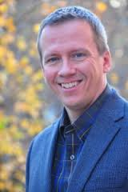
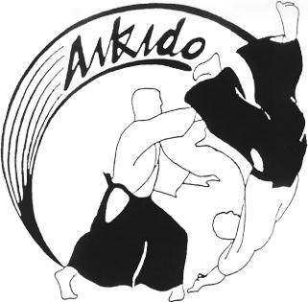
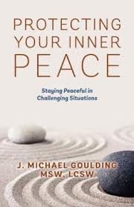
UCT member
Michael Goulding MSW, LCSW presents
Protecting Your
Inner Peace
A fusion of stress management, anger management, assertiveness training and time management.
Learn the principles of
The Japanese Art of Peace
to effectively handle verbal interactions
with the people closest to you.
Sunday Feb 16th
1:30-4:30 p.m.
Large Conference Room
Michael will use the material from his book (Available In Our Bookstore)
to show you
*how to apply your spiritual practices to your everyday life
through your actions.
*help you resolve moral dilemmas of supporting
the people in your life while setting appropriate boundaries.
Sugg. Love Offering $25
Register Online at www.unitytriangle.org or at back table

